Slide 1
Cities in shape:
Assessing the impact of urban morphology on accessibility to urban amenities
Clara Peiret-García
Prof. Rachel Franklin
Dr. Alistair Ford
Dr. Joe Matthews
Notes:
Institutions: I’m a first-year PhD student at Newcastle University. I’m part of the Centre for Doctoral Training in Geospatial Systems where we do research on anything that has to do with spatial data.
Together with my supervisors (Rachel, Ali, Joe), I’m developing this project titled Cities in shape: assessing the impact of urban morphology on accessibility to urban amenities. We are interested in knowing how the way we build and organise our cities affect the ease with which people can access opportunities in the city.

Slide 2
Contents
Background
Research Gap & Question
Methods & Data
Sample Results
Future Work & Limitations

Slide 3
Background: Accessibility & Urban Morphology
Notes:
I will start by providing a brief theoretical overview of the two key concepts of my project: accessibility and urban form.

Slide 4
Accessibility
Accessibility is the ease with which opportunities can be reached from an origin
Hansen, W. G. (1959). How accessibility shapes land use. Journal of the American Institute of planners, 25(2), 73-76.
Páez, A., Scott, D.M. and Morency, C., 2012. Measuring accessibility: positive and normative implementations of various accessibility indicators. Journal of Transport Geography, 25, pp.141-153.

Slide 5
Accessibility
Accessibility ≠ Mobility
El-Geneidy, A. M., & Levinson, D. M. (2006). Access to destinations: Development of accessibility measures.
Notes:
Accessibility is however often confused with other concepts such as mobility. While accessibility focuses on the destinations we can reach, mobility focuses on how far in terms of distance we can reach. We can have places with very low mobility, but very high access (e.g. Manhattan), and places with very high mobility but very low access (a highway in the middle of the dessert).

Slide 6
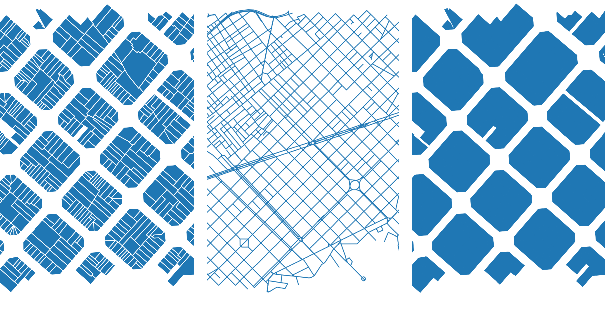
Urban Morphology
Oliveira, V. (2016). Urban Morphology: An Introduction to the Study of the Physical Form of Cities. Germany: Springer International Publishing.
Notes:
The second relevant concept is urban morphology. Urban morphology refers to the way we organise the basic elements of urban tissue – that is buildings, streets, and plots.

Slide 7
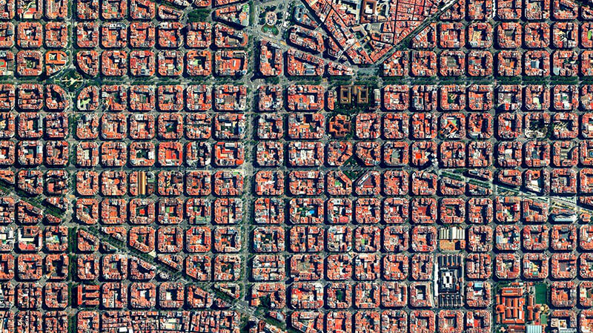
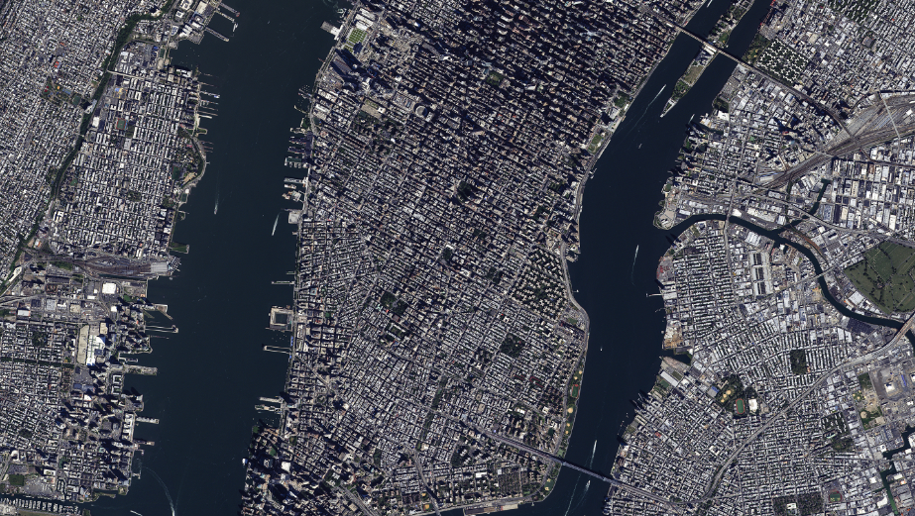
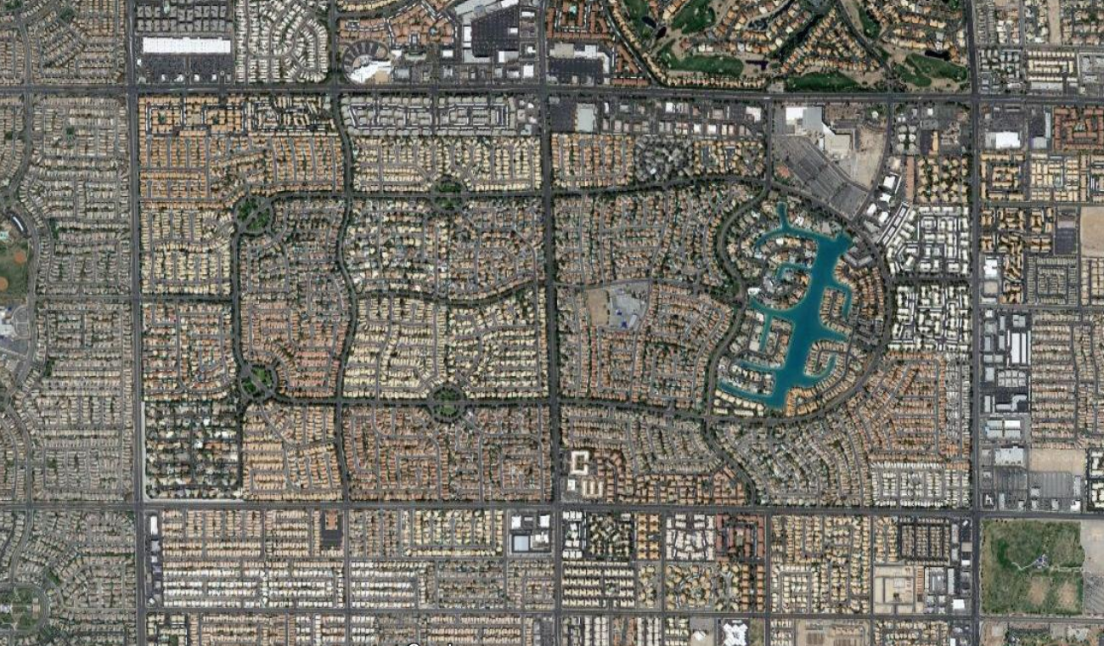
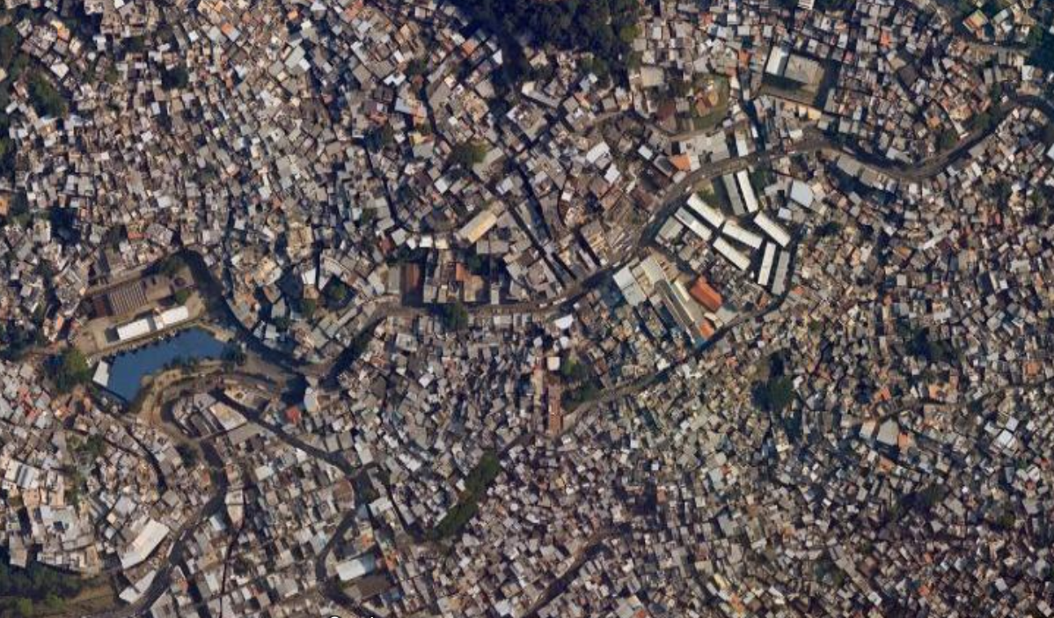
Notes:
We can organise these basic elements in many different ways. And the different ways in which we organise them will lead to different urban tissues.

Slide 8
Background
Accessibility + Urban morphology + Sustainable cities (Boeing, G., et al., 2022, Ewing, R., & Handy, S., 2009)
Urban air pollution (Burnett et al., 2018; Khomenko et al., 2021; Landrigan et al., 2018)
Motorised traffic (Kumar et al., 2020; Sicard et al., 2020; Tobías et al., 2020)
Notes:
In terms of the motivation behind this research, the are two clear interconnected drivers: urban air pollution, and its relation to motorised traffic. I don’t want to spend too much time talking about the role cities play in reducing emissions, and particularly how motorised traffic is an important contributor to this issue.

Slide 9
Background
Hansen, W. G. (1959). How accessibility shapes land use. Journal of the American Institute of Planners, 25(2), 73–76.
Lahoorpoor, B., et al. (2022). Access-oriented design? Disentangling the effect of land use and transport network on accessibility. Transportation Research Interdisciplinary Perspectives, 13. 100536.
Ewing, R., & Handy, S. (2009). Measuring the Unmeasurable: Urban Design Qualities Related to Walkability. Journal of Urban Design, 14(1), 65–84.
Calafiore, A., et al. (2022). The 20-minute city: An equity analysis of Liverpool City Region. Transportation Research Part D: Transport and Environment, 102, 103111.
Notes:
The relationship between urban morphology and accessibility has been explored widely. Very recently, Boeing et al published a paper on The Lancet where they explore the relationship between urban morphology and healthy mobility in cities. Lahoorpoor et al, also very recently, brought back the idea of transport oriented design, and re-thinking it as access-oriented design. Also, the topic has been explored in relationship to walkability. And finally, just on the topic of accessibility, it has gained great momentum after the recent development of the 15-minute city.

Slide 10
Research Gap & Questions
Notes:
There are, however, some gaps that can be explored, and some questions that can be asked.

Slide 11
Research Questions
RQ1 – How does an accessibility index to urban amenities vary when considering different demographic groups?
RQ2 – What urban tissues favour accessibility the most? (quantitative analysis)
RQ3 – Can urban tissue simulation help us evaluate the accessibility of future urban developments?

Slide 12
Methods & Data

Slide 13
Accessibility score
Morphometric analysis
Urban tissue simulation

Slide 14
Accessibility score
Morphometric analysis
Urban tissue simulation

Slide 15
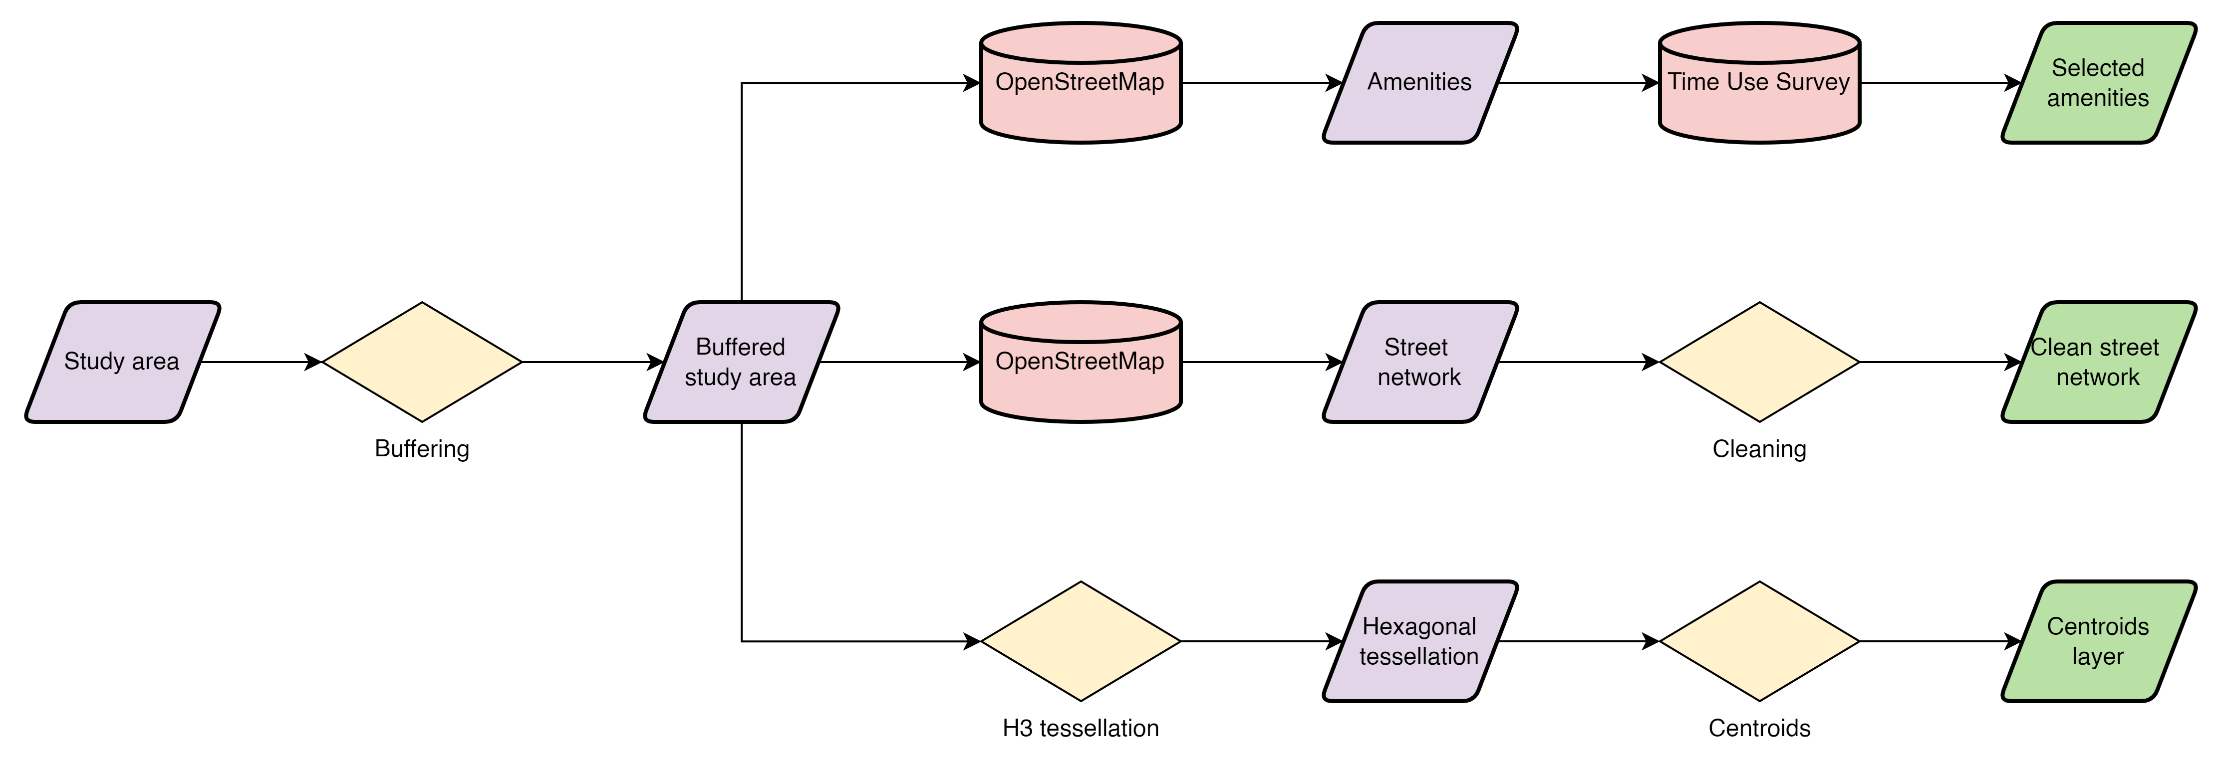
Methods & Data

Slide 16

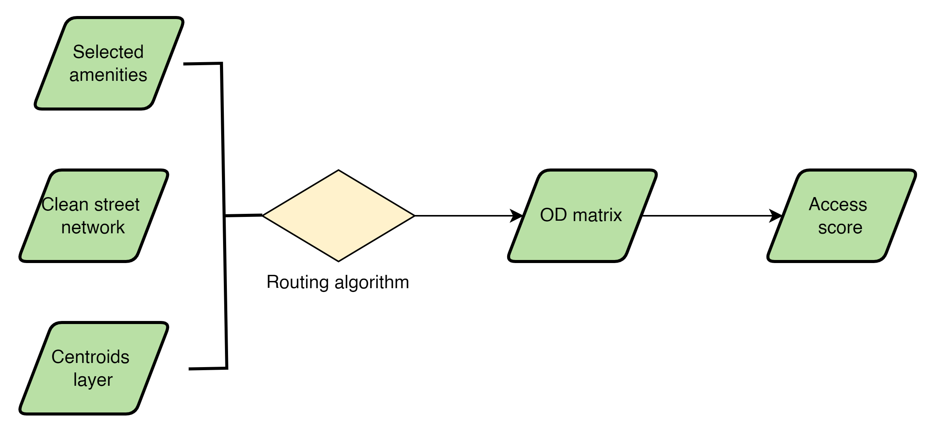
Methods & Data
Selected cities in Europe and North America
$$f (n_{amenities}, v_{amenities}, d_{amenities} , r_{efficiency})$$
Pereira, Rafael H. M., Marcus Saraiva, Daniel Herszenhut, Carlos Kaue Vieira Braga, and Matthew Wigginton Conway. 2021. “R5r: Rapid Realistic Routing on Multimodal Transport Networks with R5 in R.” Findings, March.

Slide 17
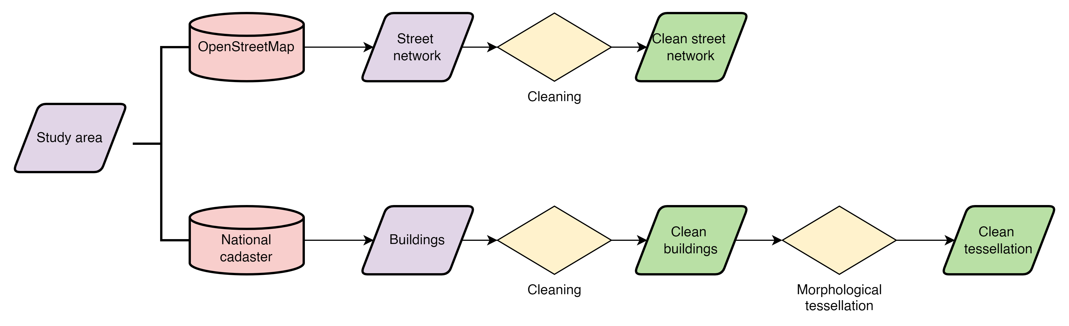
Methods & Data

Slide 18

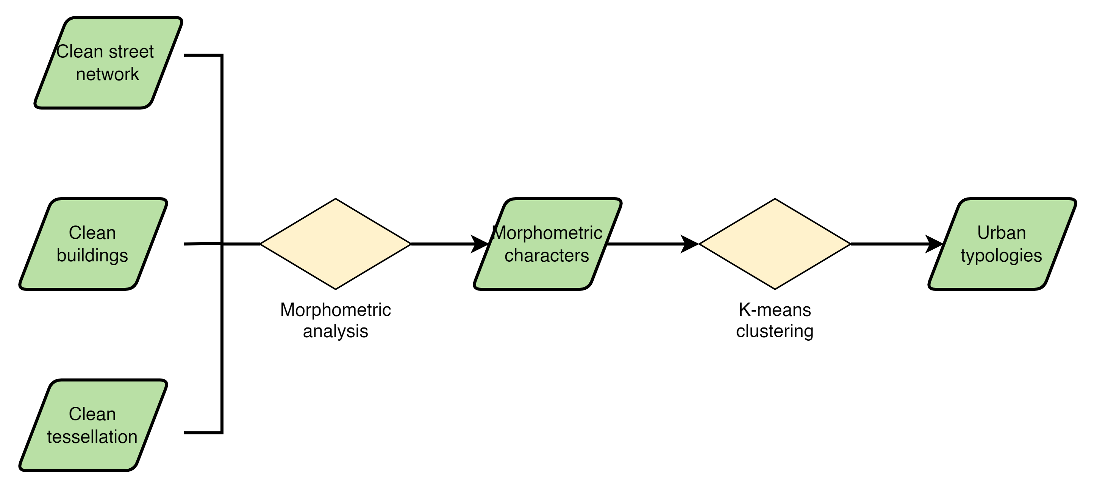
Methods & Data
Fleischmann, Martin. (2019). momepy: Urban Morphology Measuring Toolkit. Journal of Open Source Software. 4. 1807.

Slide 19
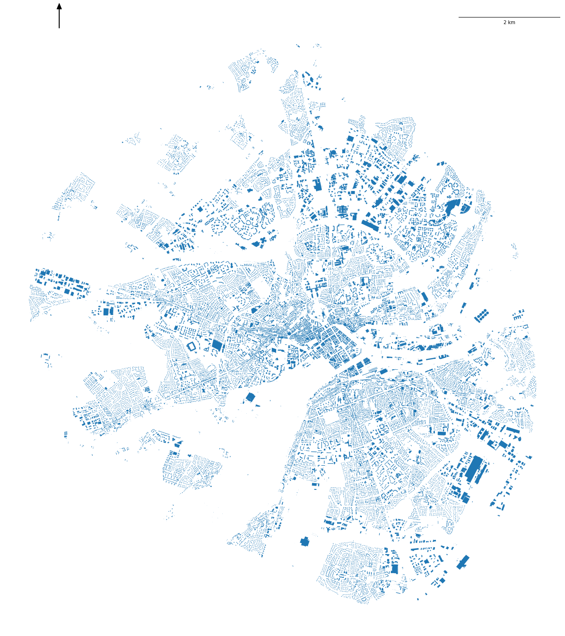
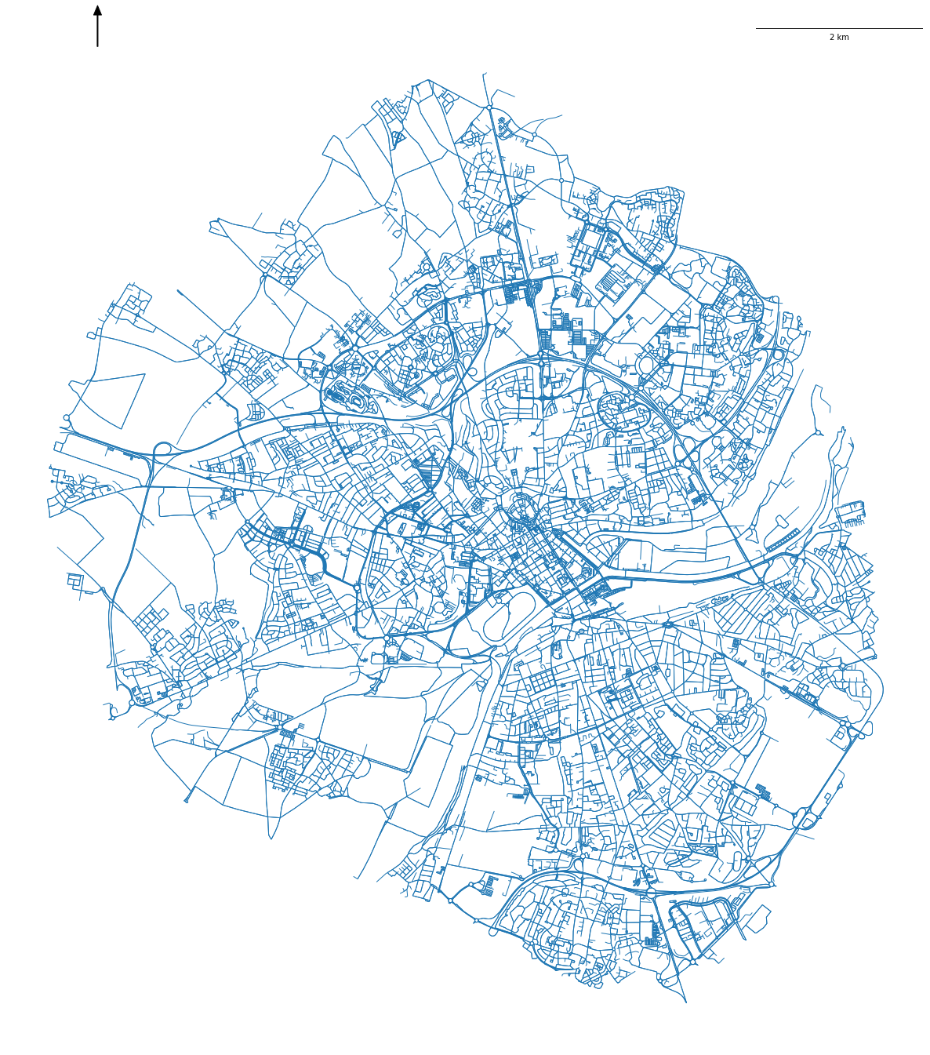

Slide 20
Sample Results

Slide 21



Slide 22
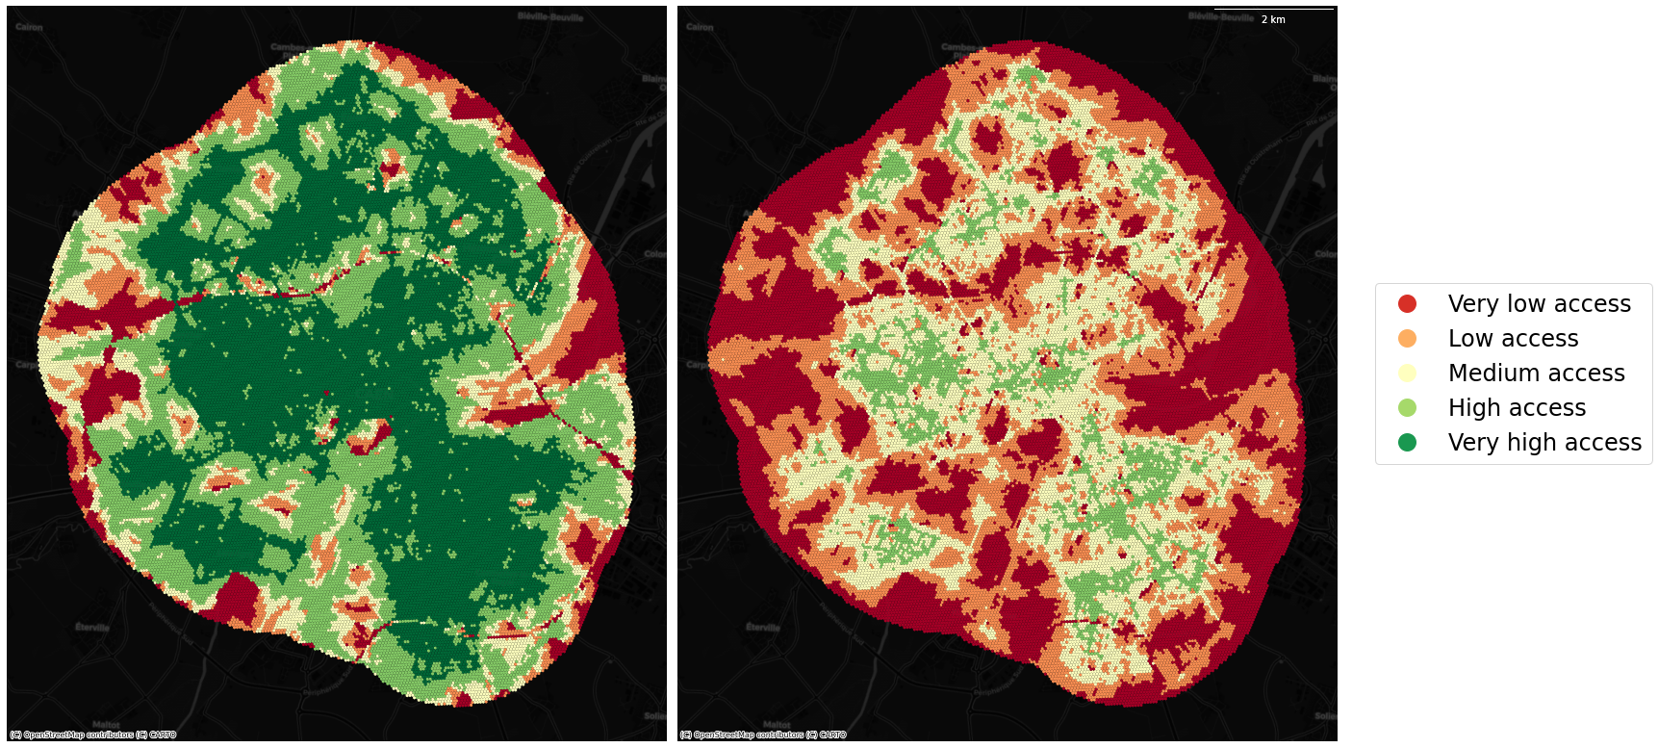
“Accessibility” score for adults in Caen for a 15 min walking distance.
“Accessibility” score for seniors in Caen for a 15 min walking distance.

Slide 23
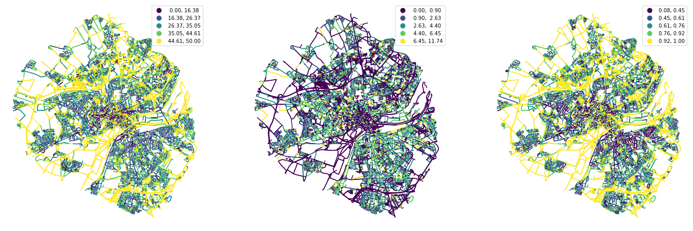
Width
Width deviation
Openness

Slide 24
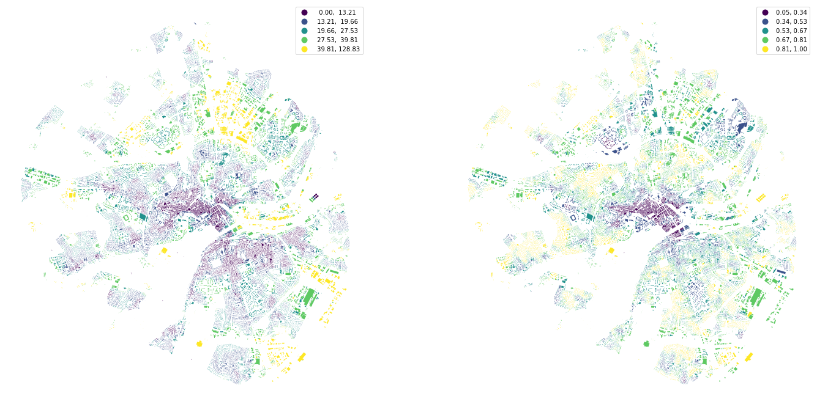
Inter-building distance
Adjacency

Slide 25
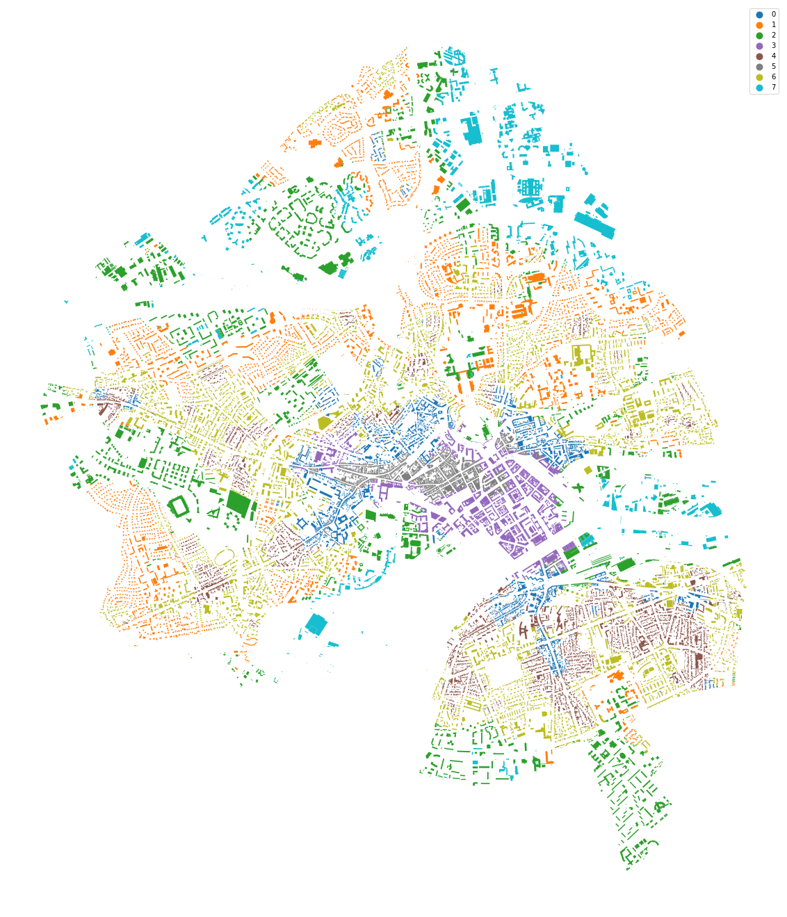
Urban typologies

Slide 26
Future Work & Limitations

Slide 27
Future Work
Time Use Survey for amenity weighting - UK
GWR to quantify relationship between access and form.
Deep Learning for synthetic urban tissue generation.
Dasymetric population methods for socioeconomic variables

Slide 28
Limitations
The limits of open data

Slide 29

Thank you

Slide 30
References
Boeing, et al. (2022). Using open data and open-source software to develop spatial indicators of urban design and transport features for achieving healthy and sustainable cities. The Lancet Global Health, 10(6), e907–e918.
Burnett, R., Chen, H., Szyszkowicz, M., & et al. (2018). Global estimates of mortality associated with longterm exposure to outdoor fine particulate matter. Proceedings of the National Academy of Sciences of the United States of America, 115(38), 9592–9597.
Calafiore, A., et al. (2022). The 20-minute city: An equity analysis of Liverpool City Region. Transportation Research Part D: Transport and Environment, 102, 103111.
El-Geneidy, A. M., & Levinson, D. M. (2006). Access to destinations: Development of accessibility measures.
Ewing, R., & Handy, S. (2009). Measuring the Unmeasurable: Urban Design Qualities Related to Walkability. Journal of Urban Design, 14(1), 65–84.
Ewing, R., & Handy, S. (2009). Measuring the Unmeasurable: Urban Design Qualities Related to Walkability. Journal of Urban Design, 14(1), 65–84.
Fleischmann, Martin. (2019). momepy: Urban Morphology Measuring Toolkit. Journal of Open Source Software. 4. 1807.
Hansen, W. G. (1959). How accessibility shapes land use. Journal of the American Institute of planners, 25(2), 73-76.

Slide 31
References
Hansen, W. G. (1959). How accessibility shapes land use. Journal of the American Institute of Planners, 25(2), 73–76.
Hansen, W. G. (1959). How accessibility shapes land use. Journal of the American Institute of Planners, 25(2), 73–76.
Khomenko, S., Cirach, M., Pereira-Barboza, E., Mueller, N., Barrera-Gómez, J., Rojas-Rueda, D., de Hoogh, K., Hoek, G., & Nieuwenhuijsen, M. (2021). Premature mortality due to air pollution in European cities: a health impact assessment. The Lancet Planetary Health, 5(3), e121–e134.
Kumar, P., Hama, S., Omidvarborna, H., Sharma, A., Sahani, J., Abhijith, K. v, Debele, S. E., Zavala-Reyes, J. C., Barwise, Y., & Tiwari, A. (2020). Temporary reduction in fine particulate matter due to ‘anthropogenic emissions switch-off’ during COVID-19 lockdown in Indian cities. Sustainable Cities and Society, 62.
Lahoorpoor, B., et al. (2022). Access-oriented design? Disentangling the effect of land use and transport network on accessibility. Transportation Research Interdisciplinary Perspectives, 13. 100536.
Landrigan, P. J., Fuller, R., Acosta, N. J. R., & et al. (2018). The Lancet Commission on pollution and health. The Lancet, 391(10119), 462–512. https://doi.org/10.1016/S0140-6736(17)32345-0
Oliveira, V., Oliveira, V. (2016). Urban Morphology: An Introduction to the Study of the Physical Form of Cities. Germany: Springer International Publishing.

Slide 32
References
Páez, A., Scott, D.M. and Morency, C., 2012. Measuring accessibility: positive and normative implementations of various accessibility indicators. Journal of Transport Geography, 25, pp.141-153.
Pereira, Rafael H. M., Marcus Saraiva, Daniel Herszenhut, Carlos Kaue Vieira Braga, and Matthew Wigginton Conway. 2021. “R5r: Rapid Realistic Routing on Multimodal Transport Networks with R5 in R.” Findings, March.
Sicard, P., de Marco, A., Agathokleous, E., Feng, Z., Xu, X., Paoletti, E., Rodriguez, J. J. D., & Calatayud, V. (2020). Amplified ozone pollution in cities during the COVID-19 lockdown. Science of the Total Environment, 735.
Tobías, A., Carnerero, C., Reche, C., Massagué, J., Via, M., Minguillón, M. C., Alastuey, A., & Querol, X. (2020). Changes in air quality during the lockdown in Barcelona (Spain) one month into the SARS-CoV-2 epidemic. Science of the Total Environment, 726.

